Slide 1

911 CALLS CLASSIFICATION
Group-8
PRESENTED BY:
Anuj Gupta -AXG230072
Sampreethi Bokka-SXB220212
Abhigna Alagoni - AXA230129
Nikitha Jillella-NXJ210035
Jeevithesh Reddy Narravula Reddy-JXN21003

Slide 2


PROJECT OBJECTIVES
• Develop a machine learning model capable of predicting high priority 911 calls.
• Evaluate the model's performance using relevant metrics.
• Provide actionable insights into the factors influencing 911 calls

Slide 3

Variables
1. recordId: Record number
2. callKey: 'callKey' is a unique reference number on every record.
3. callDateTime: date of record (year/month/day hour: minute)
4. priority: The importance of the service that is expected to be taken.
5. district: Name of the specific district within the state.
6. description: name of illegal activity
7. callNumber: Phone number (Encrypted)
8. incidentLocation: location where incident occurred.
9. location: The exact location of the reporter
10. Neighborhood: The name of the neighborhood
11. PoliceDistrict: geographical area patrolled by a police force.
12. CouncilDistrict: type of local government division
13. SheriffDistricts: Local government has divided the state into several sheriff's office so that
they can better service.
14. Community_Statistical_Areas: Community Statistical Areas are clusters of neighborhoods
developed by the City's Planning Department based on recognizable city neighborhoods.
15. CENSUS_TRACTS: UNIQUELY NUMBERED IN EACH COUNTY WITH A NUMERIC CODE.
16. ZIPCODE: THE POSTAL CODE OF THE LOCATION
17. NEEDSSYNC: REFERS TO THE PROCESS OF ENSURING THAT THE DATA ON TWO OR MORE DEVICES IS
CONSISTENT AND UP TO DATE.(IT IS USED IN ARCGIS)
18. ESRI_OID: IT IS USED IN ARCGIS

Slide 4
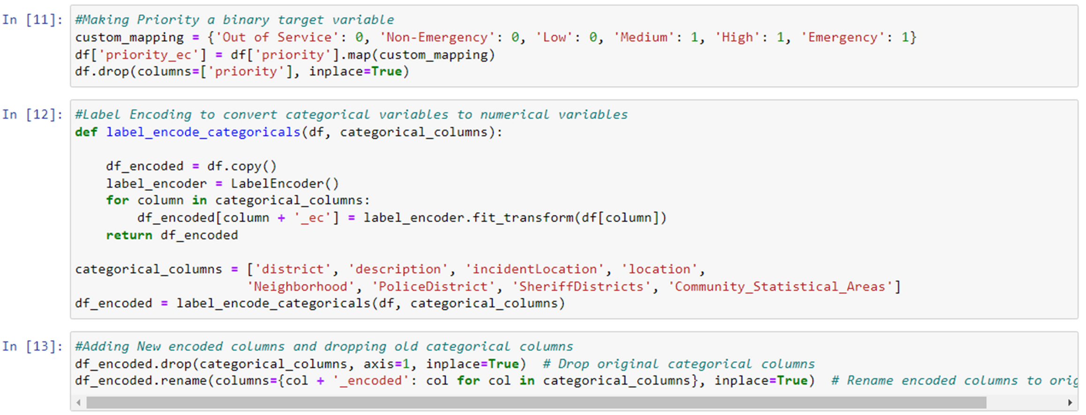
Label Encoding

Slide 5
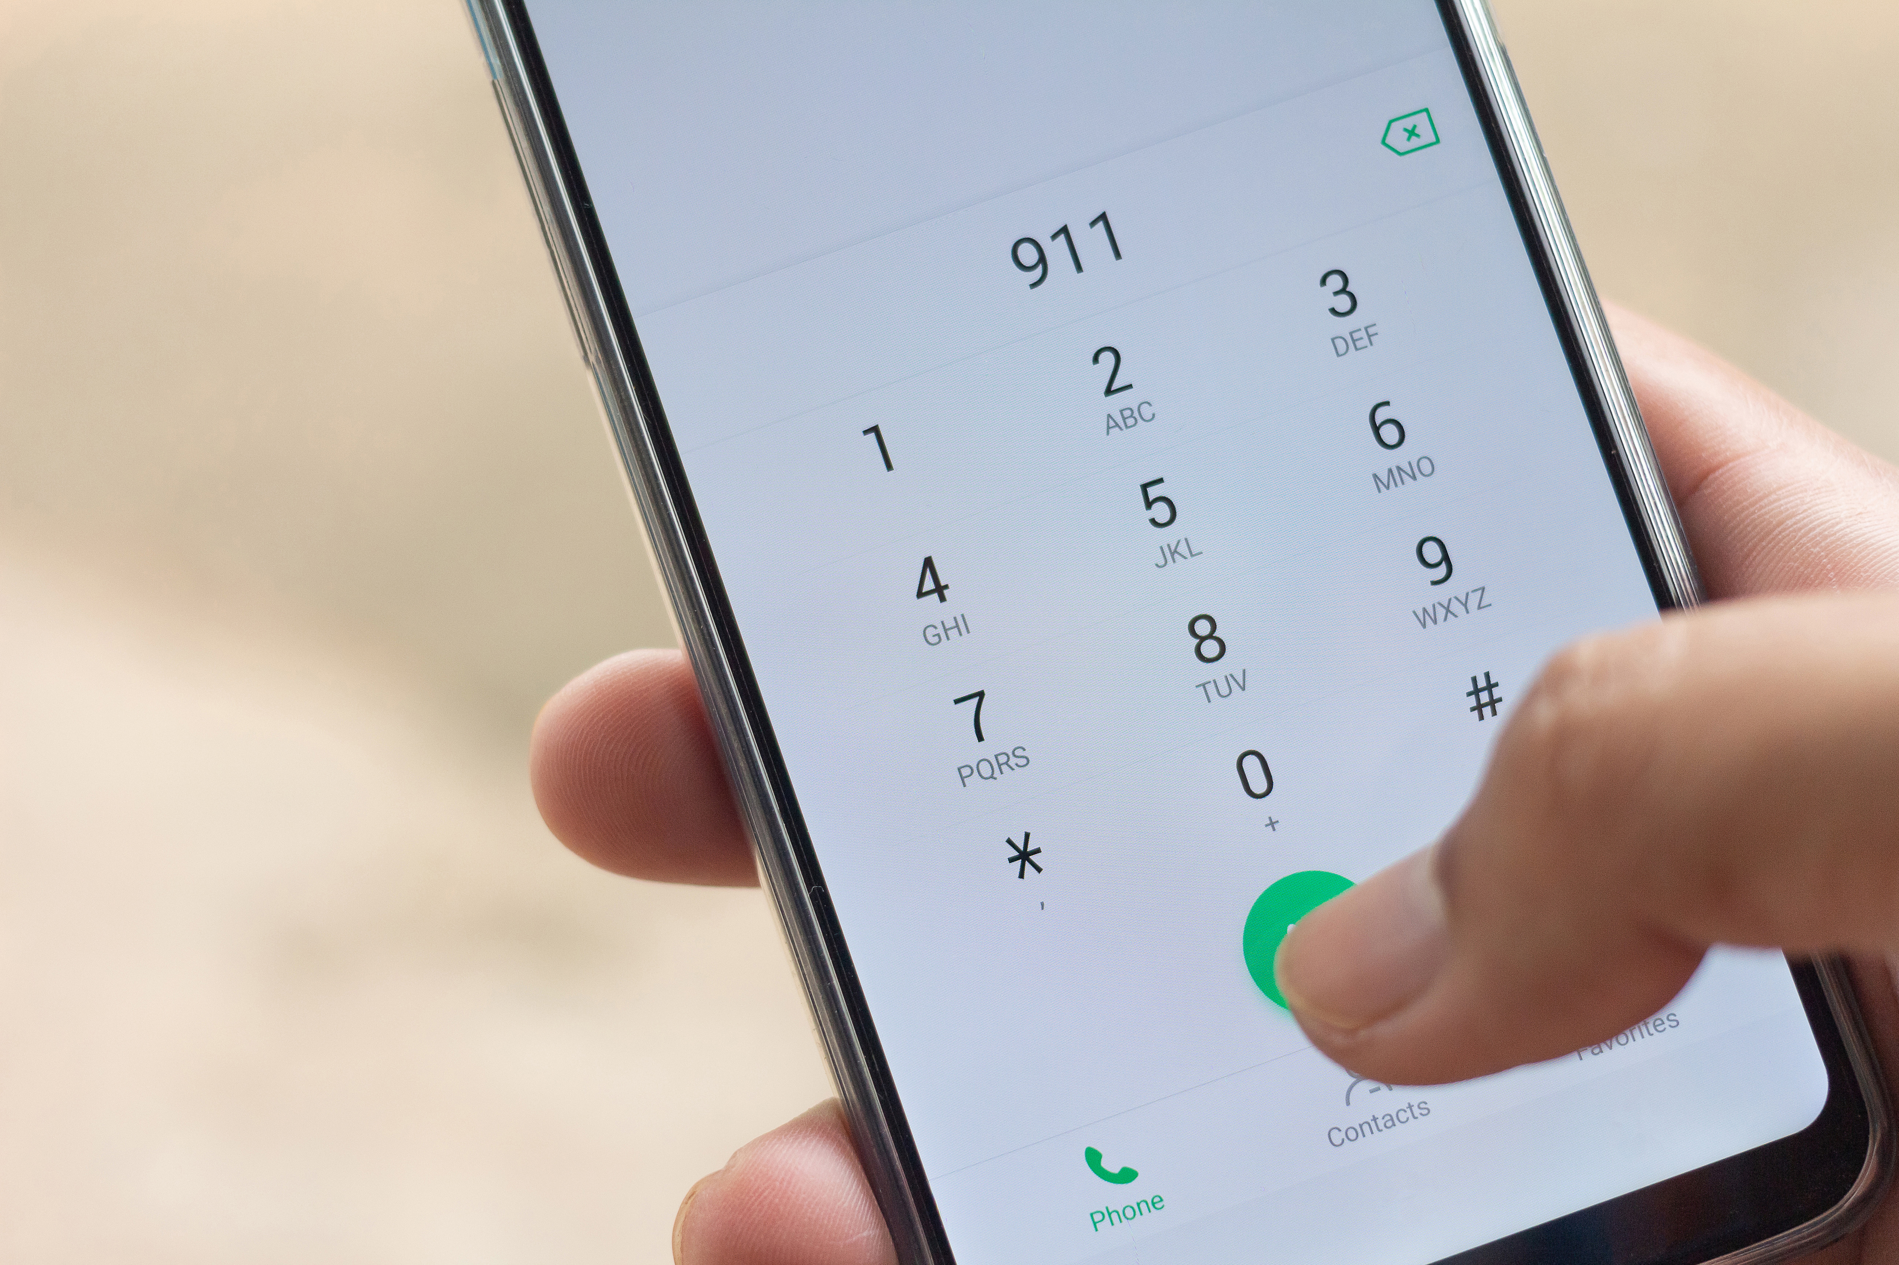
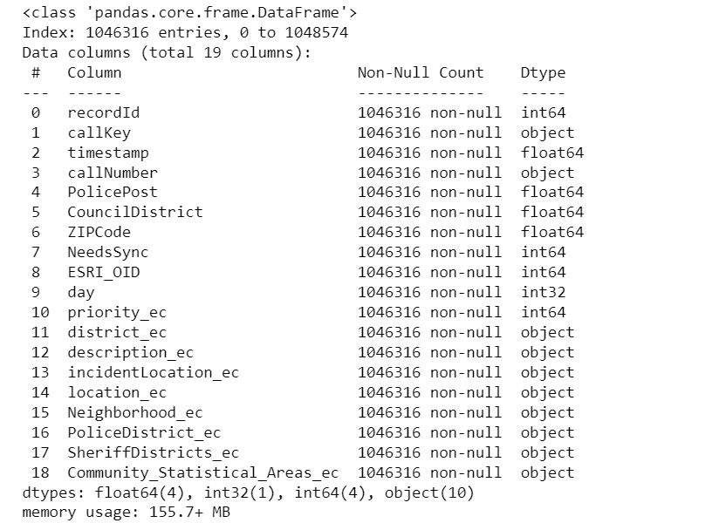
STRUCTURE OF ENCODED DATA SET:

Slide 6

MACHINE LEARNING MODELS USED:
KNN Algorithm
Logistic Regression
Decision Tree
Random Forest Classifier
SVM

Slide 7

KNN ALGORITHM:
The best hyperparameter chosen by the grid search is n_neighbors = 5
The test accuracy of the KNN model with the best hyperparameters on the test set is approximately 76%
The validation score of the KNN model with the best hyperparameters obtained through cross-validation is approximately 75.65%.

Slide 8
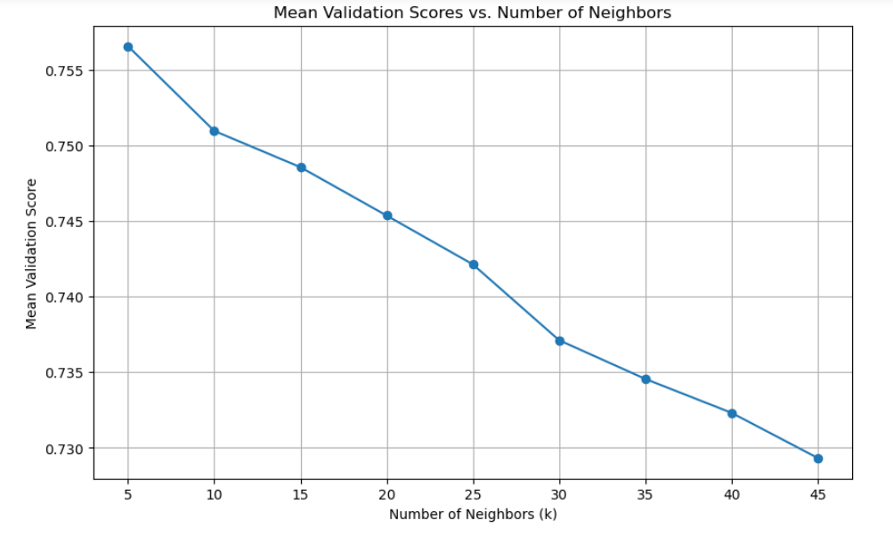
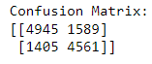

KNN ALGORITHM:
Accuracy
Precision
Recall
F1 score
0.76
0.74
0.764
0.75

Slide 9
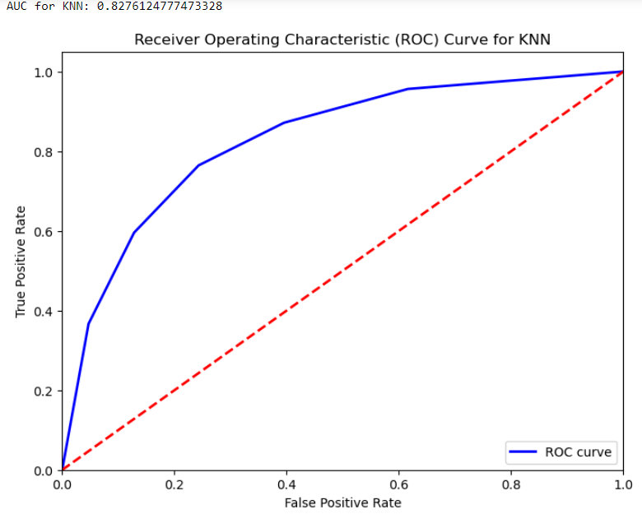
AUC & ROC:
AUC for KNN: 0.827

Slide 10
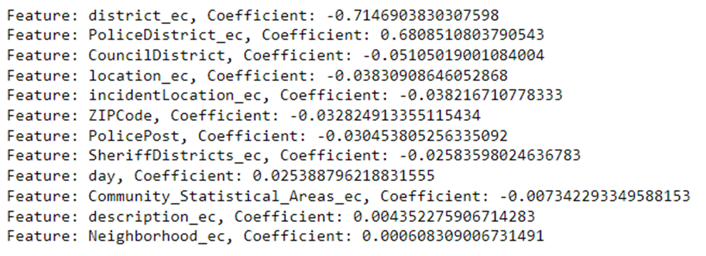
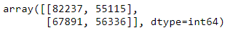
LOGISTIC REGRESSION:
ACCURACY: 0.52
PRECISION: 0.50
RECALL: 0.45
F1 SCORE: 0.47

Slide 11
LOGISTIC REGRESSION:
Based on the coefficient values, district_ec and PoliceDistrict_ec appear to be the most important features for determining the priority of 911 calls.
A higher value of district_ec is associated with a lower priority of the call, while a higher value of PoliceDistrict_ec is associated with a higher priority of the call.
The district where the call originates from (District_EC) has a negative impact on the priority level. Certain districts may have fewer incidents or lower urgency, leading to lower priority.
The specific police district associated with the call (PoliceDistrict_EC) has a positive impact on the priority level. Some police districts may handle more critical incidents or have higher urgency, leading to higher priority for calls from those areas.

Slide 12
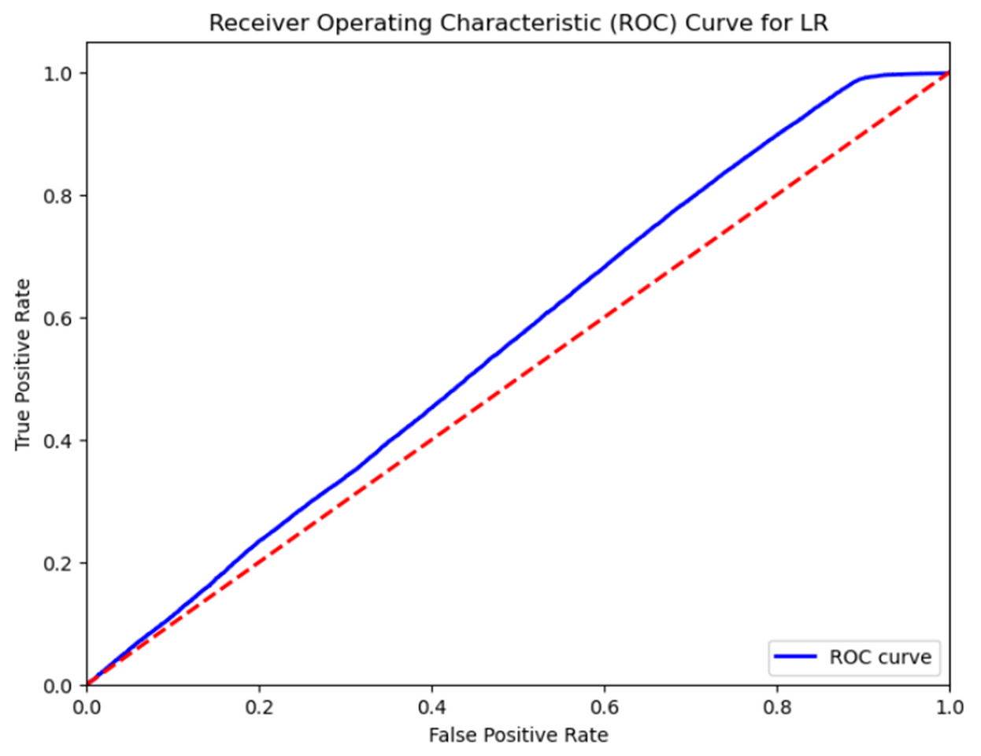
LOGISTIC REGRESSION:
AUC for LR: 0.7977

Slide 13
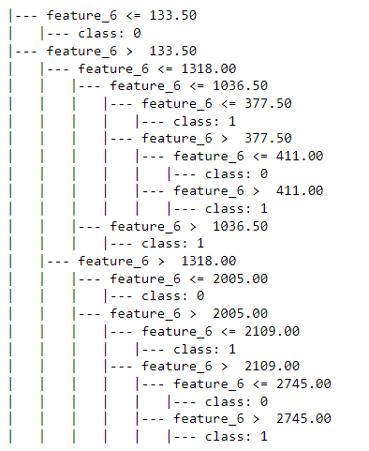

DECISION TREE:

Slide 14
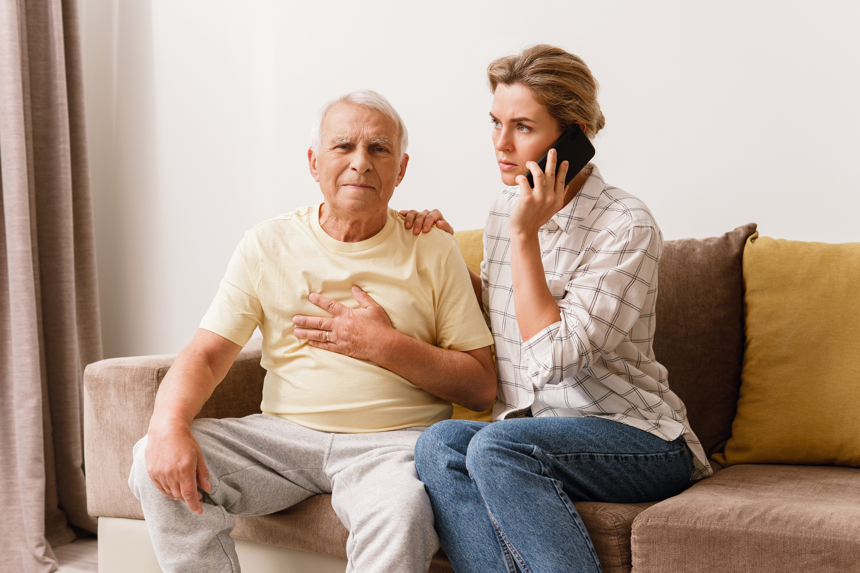
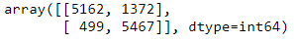
DECISION TREE:
The best hyperparameters chosen for the decision tree classifier are:
1.max_depth: 5
2.min_samples_split: 2
3.max_leaf_nodes: 9
The accuracy score on the test set is reported as 0.85
The cross-validation score (best_score_) is reported as 0.853

Slide 15
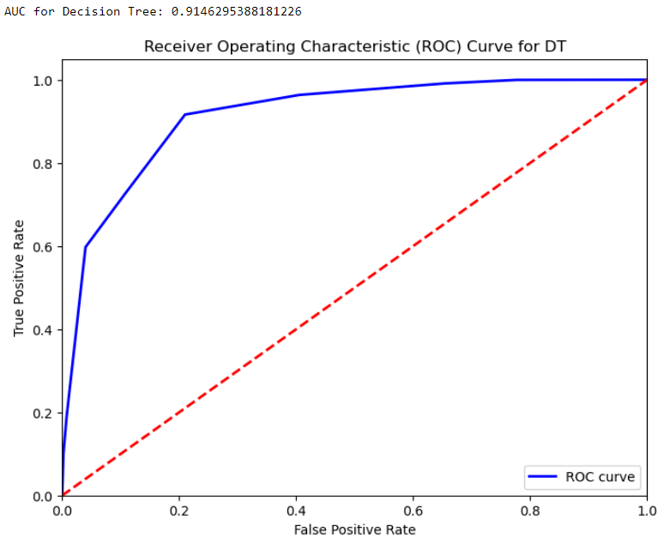
DECISION TREE:
AUC for DT: 0.914
ACCURACY: 0.85
PRECISION: 0.79
RECALL: 0.91
F1 SCORE: 0.85

Slide 16

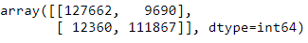
RANDOM FOREST CLASSIFIER:
No of Estimators = 500
Max Samples = 20000
ACCURACY: 0.85
PRECISION: 0.79
RECALL: 0.91
F1 SCORE: 0.85
ACCURACY: 0.91
PRECISION: 0.92
RECALL: 0.90
F1 SCORE: 0.91

Slide 17
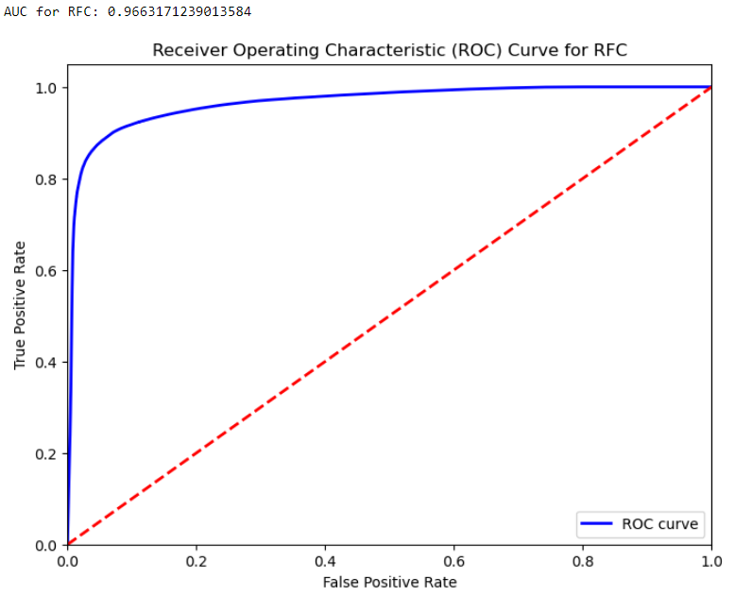
RANDOM FOREST CLASSIFIER:
AUC for RFC: 0.966

Slide 18
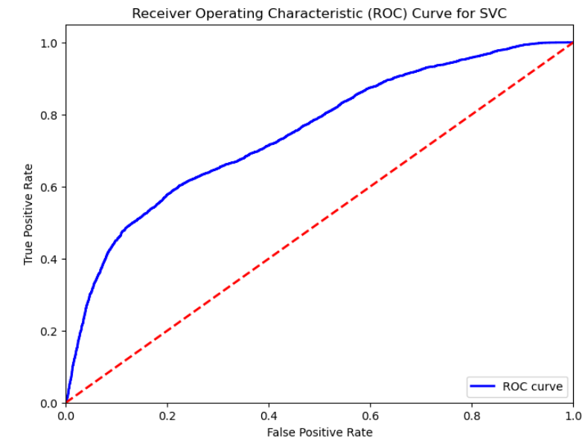
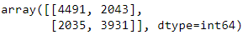
SVM:
AUC for SVM: 0.749
ACCURACY: 0.67
PRECISION: 0.65
RECALL: 0.65
F1 SCORE: 0.65

Slide 19
SVM:
The accuracy of the Support Vector Machine (SVM) model on the test set is approximately 67%
The Area Under the Receiver Operating Characteristic (ROC) Curve (AUC) for the SVM model is approximately 0.75
These results indicate that the SVM model, trained on scaled features, performs moderately well in predicting the priority of 911 calls in the dataset.

Slide 20

THANK YOU

